Slide 1




Slide 2
Walt Vernon
Chief Executive Officer, Mazzetti Inc, San Francisco, California
Electrical Engineering and Mathematics Degrees from Vanderbilt University
30 years of experience in the research, planning, and design of healthcare facilities
Active involvement on committees that impact the codes and standards involved in the design of healthcare facilities, including ASHRAE SSPC 189.3

Slide 3

Decarbonizing Healthcare

Slide 4

“Boundary Issues”
In some ways, similar to other buildings
Unique regulatory and process needs
Organizational boundaries matter
New vs. Existing
Which gasses?
Which Scopes?
Which PART of which scopes?

Slide 5
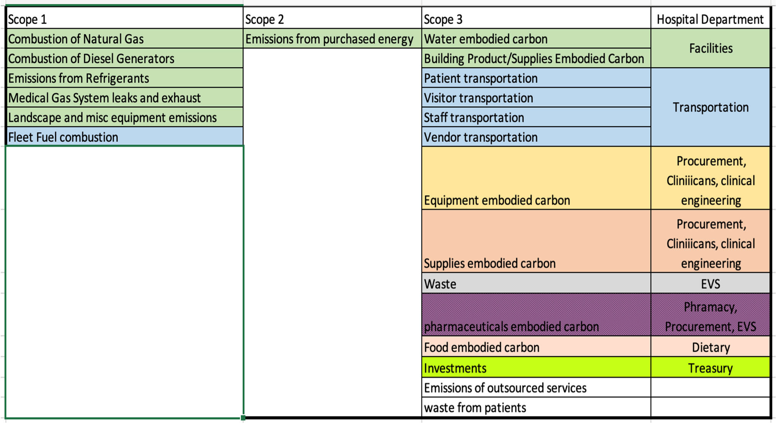

Slide 6
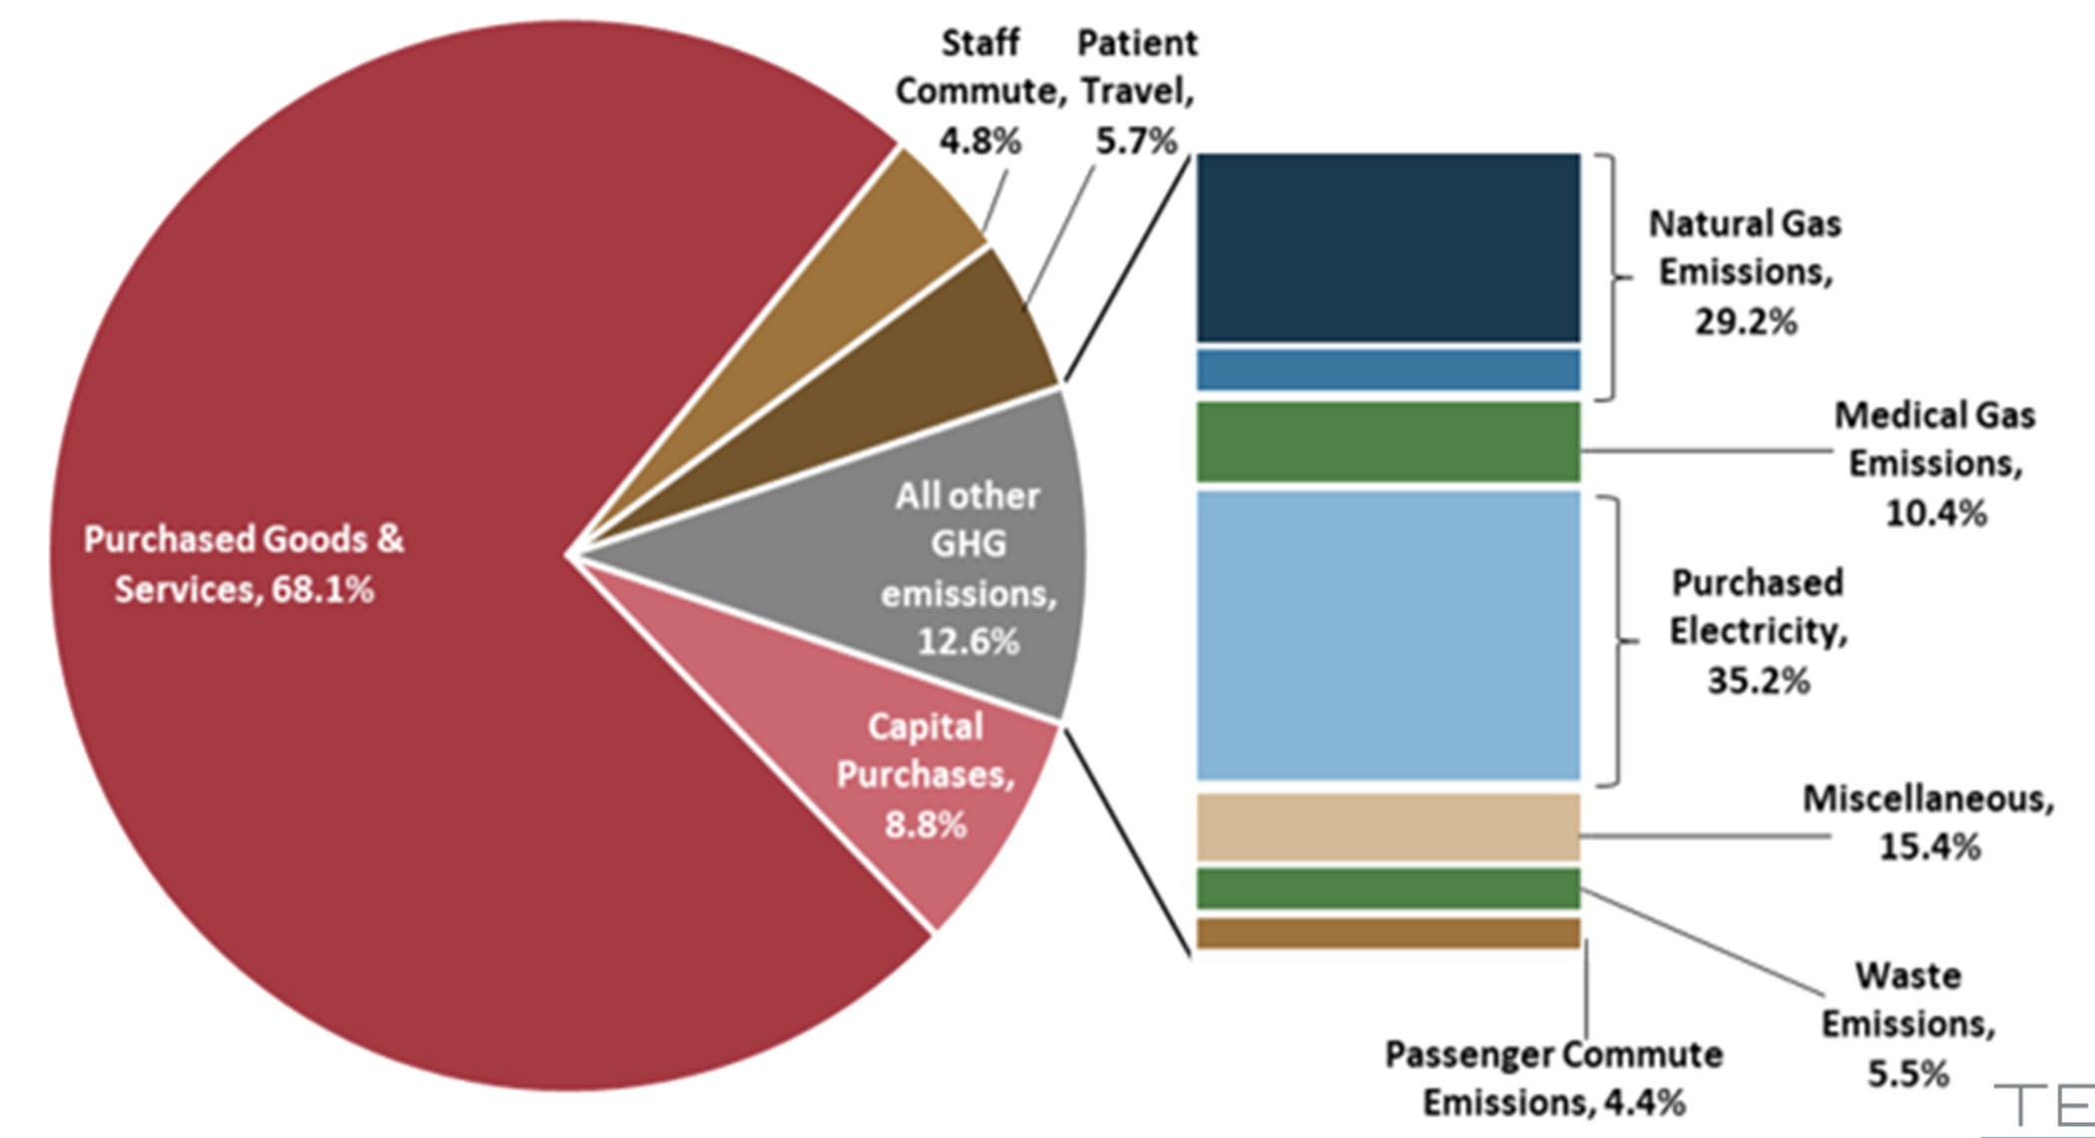

Slide 7
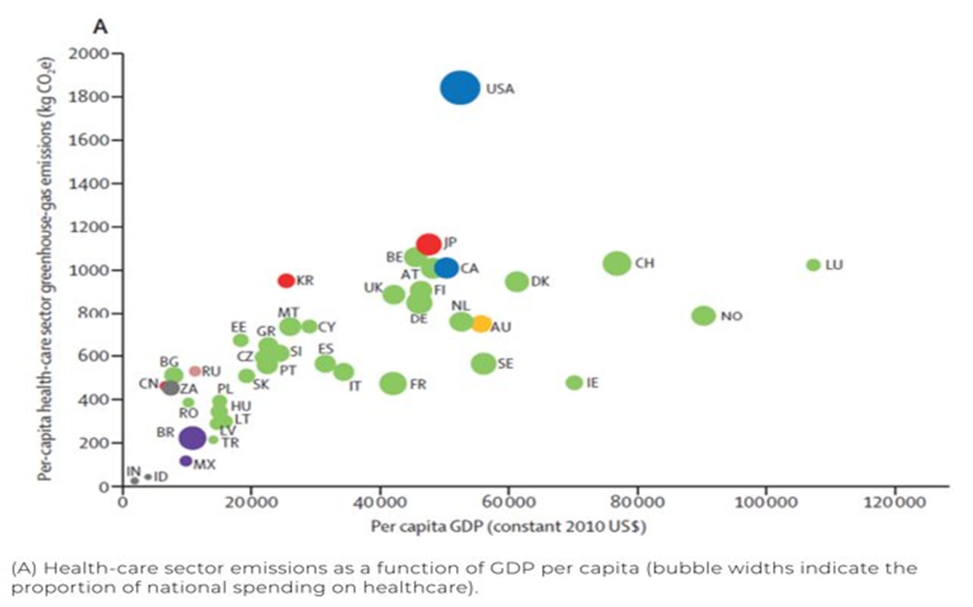

Slide 8

Why is Healthcare HARD?

Slide 9
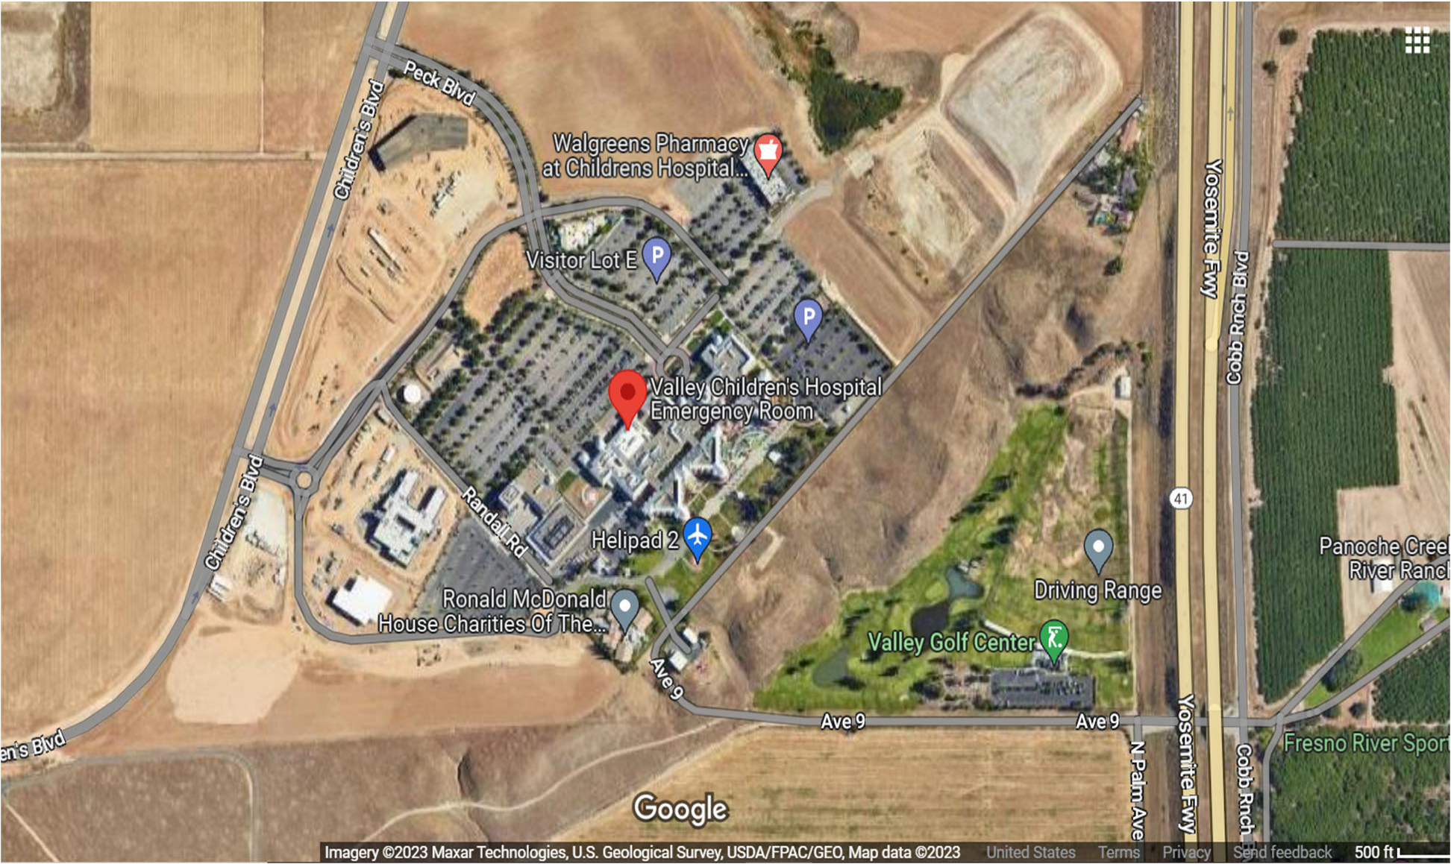

Slide 10
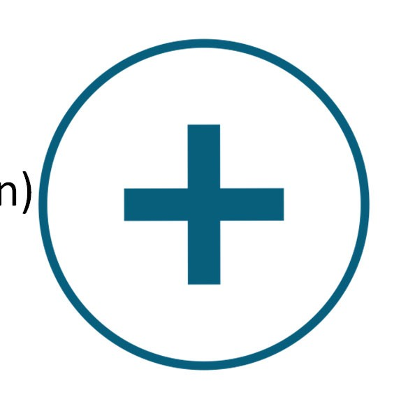
Context for Engineering in Healthcare in 2022
Worst pandemic in 100 years
Urgent, wicked problems of changing climate
  Resilience
  Decarbonization
Intensely risk‐averse function (form follows? functi
Intensely broken industry (especially economics)
on)

Slide 11

Detrimental impacts due to:
Sicker patients
Higher expenses
Fewer outpatient visits
https://www.aha.org/guidesreports/2021‐09‐21‐financial‐effects‐covid‐19‐hospital‐outlook‐remainder‐2021
11

Slide 12

6E+09
Business as usual
5E+09
Capital projects.
_{4E+09} Operations
Behavior
3E+09
2E+09
1E+09
0
2012
2013
2014
2015
2016
2017
2018
2019
2020
2021

Slide 13
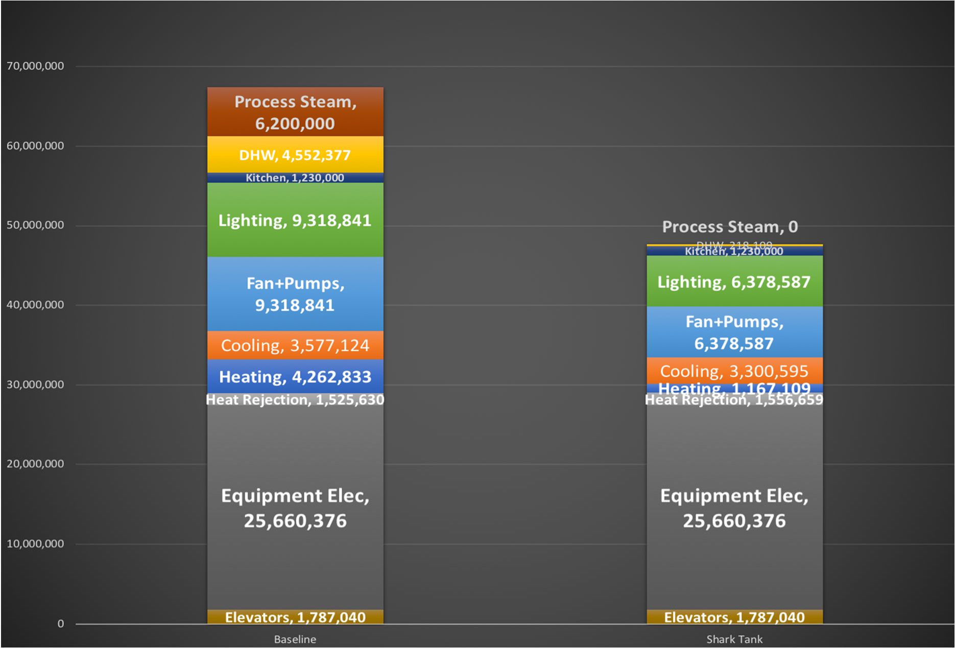
BASELINE
vs.
SHARK TANK
EUI
141
EUI
97

Slide 14
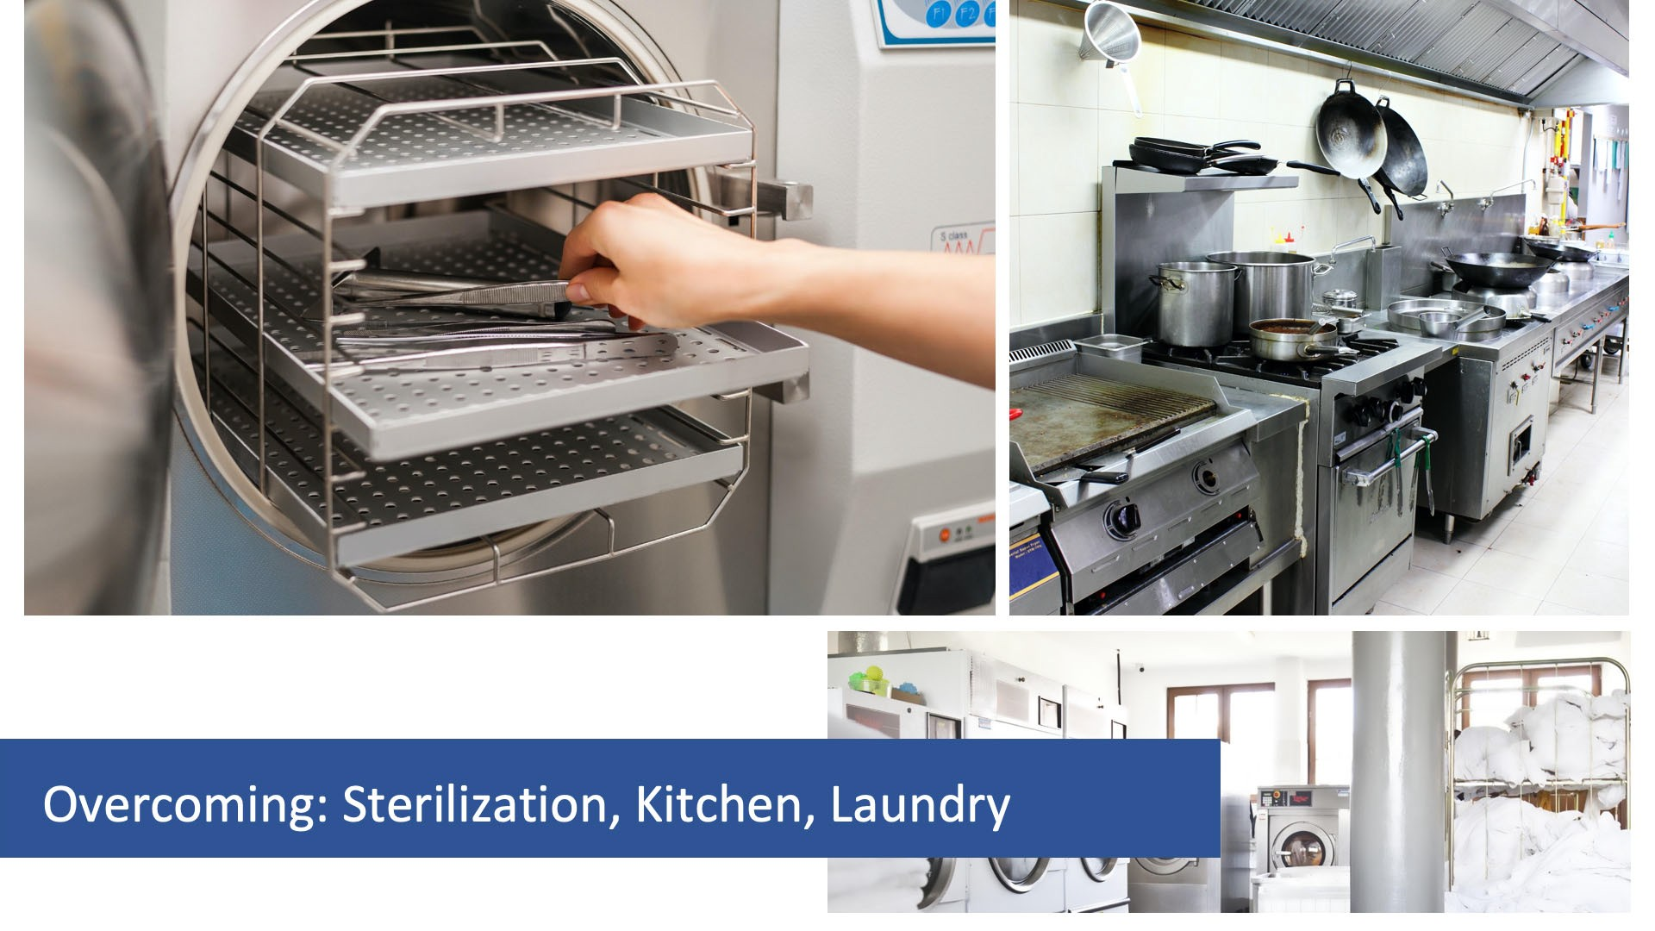

Slide 15
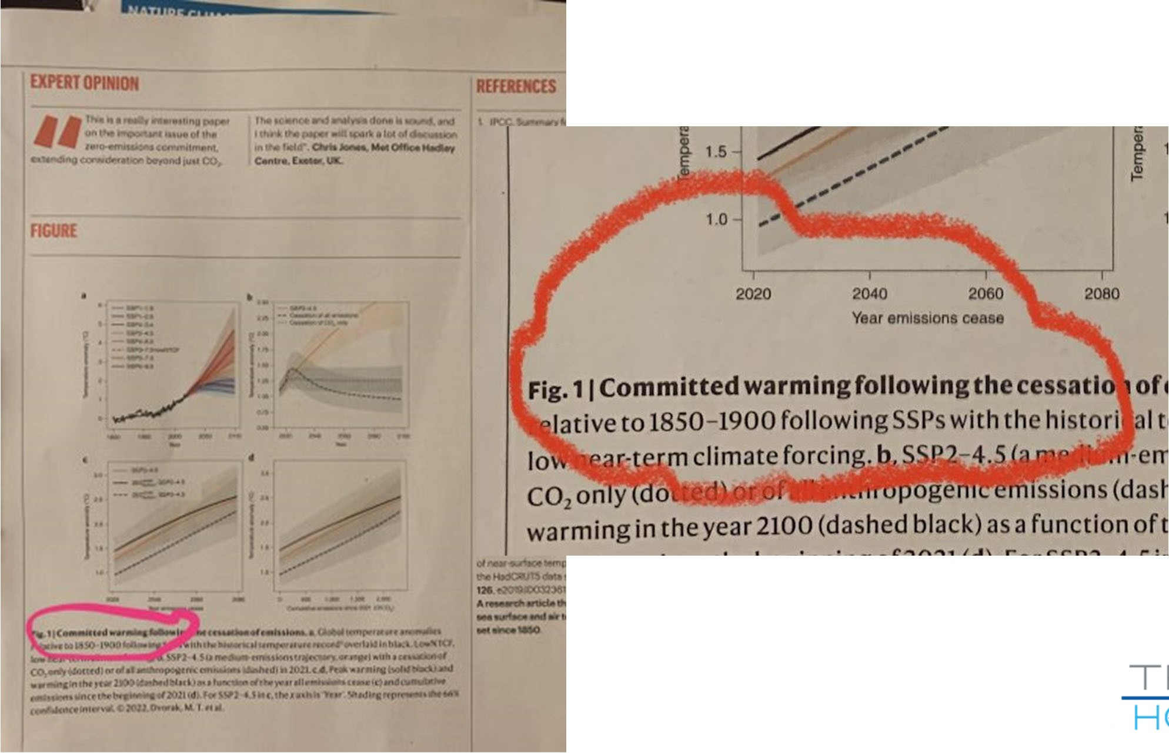

Slide 16
Why is Healthcare READY?

Slide 17


Slide 18


45% by 2030
100% by 2050

Slide 19
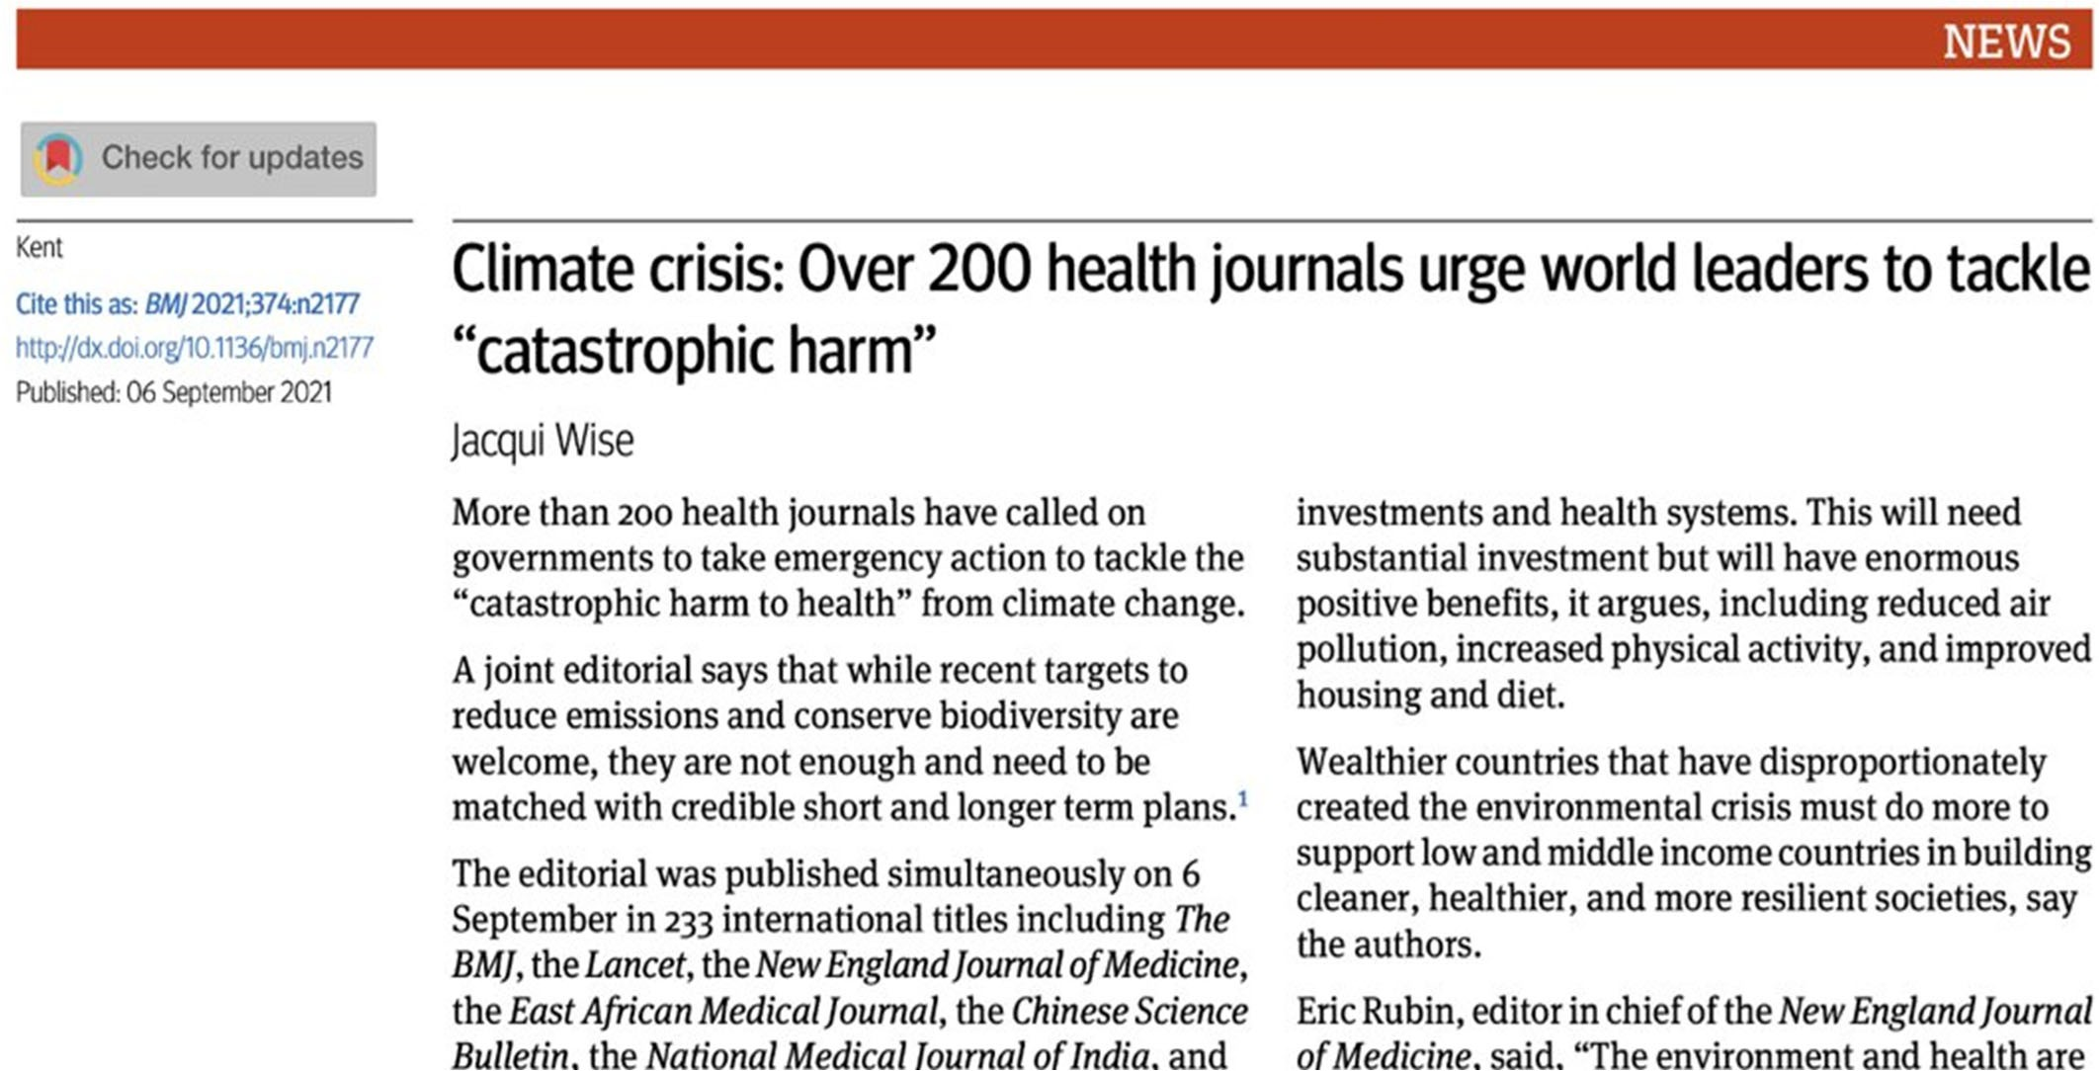

Slide 20


Slide 21

US National Academies (NASEM)
Healthcare challenged to
REDUCE
It’s carbon emissions
BY 50%
By 2030

Slide 22

US National Academies (NASEM)

Slide 23

How can Healthcare DO IT?

Slide 24

No more burning!

Slide 25
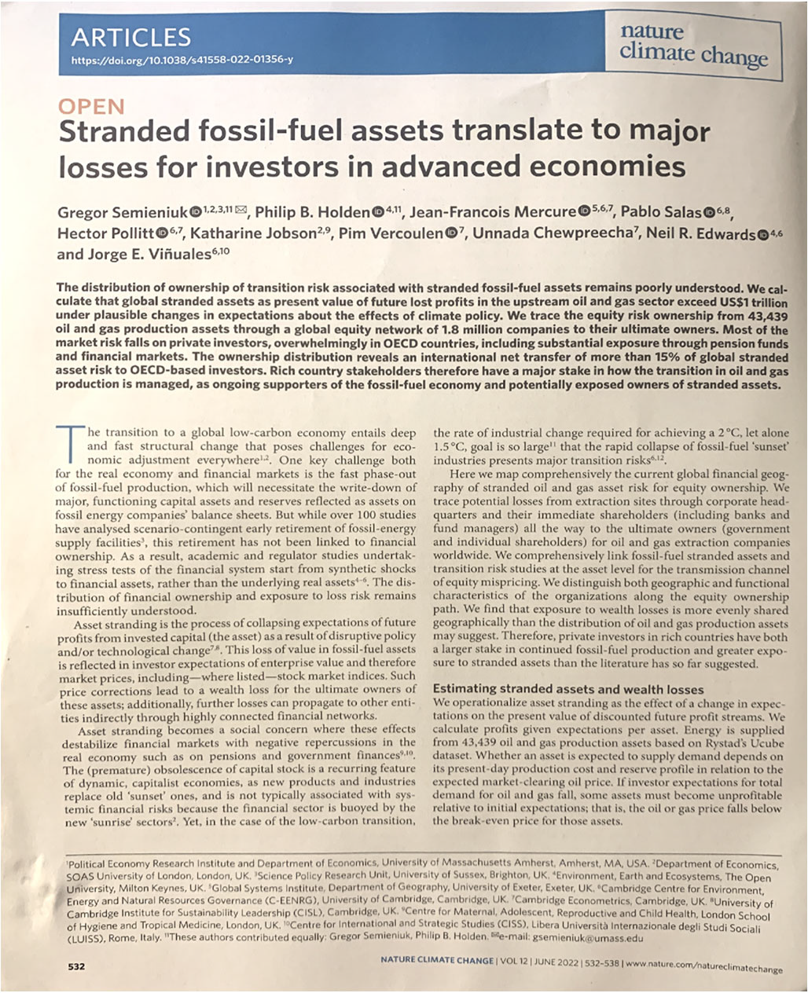

Slide 26
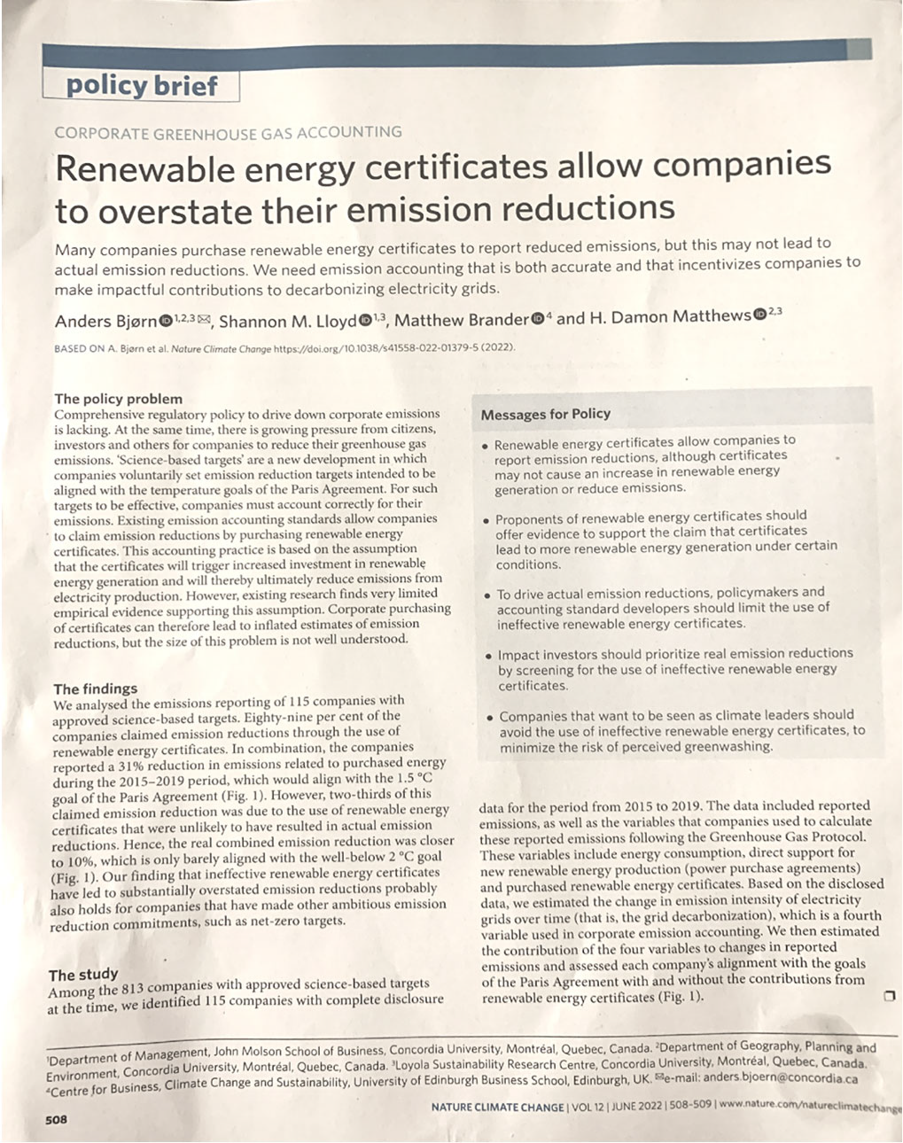

Slide 27
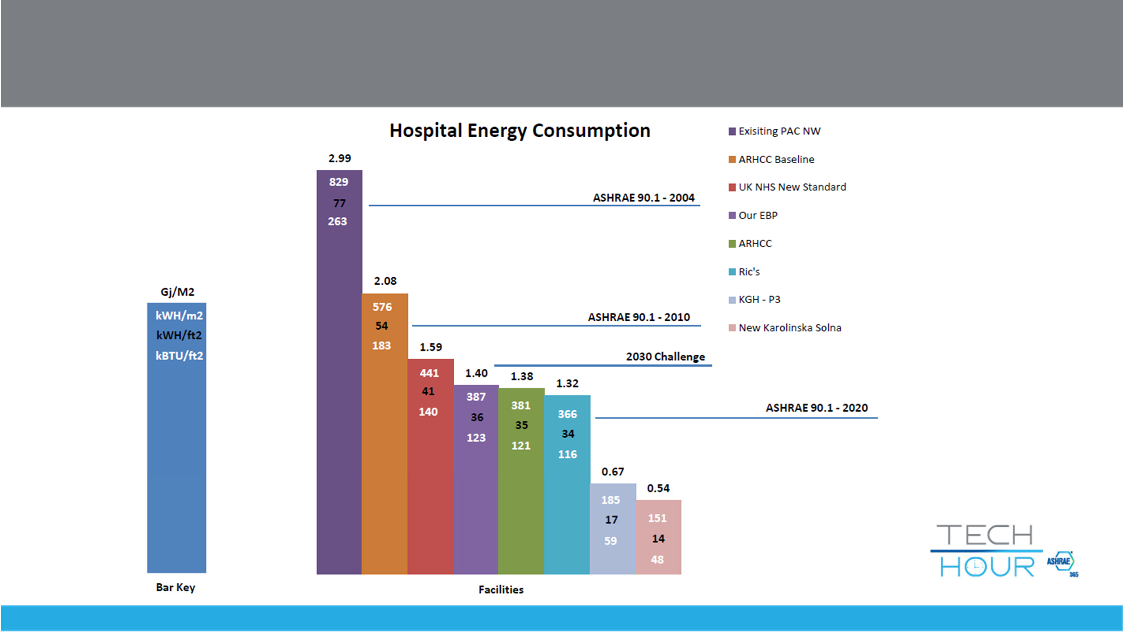
Energy Reduction Opportunity

Slide 28




Living Guidebook for Decarbonizing Healthcare

Slide 29



Slide 30
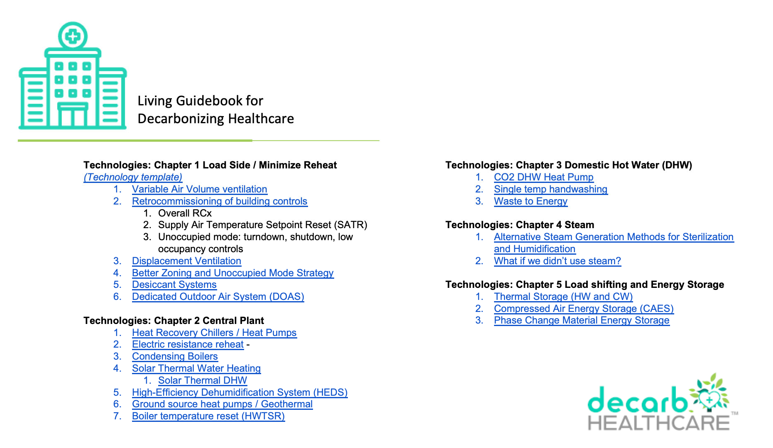

Slide 31














Current State
Reheat
Heating Hot Water Domestic Hot Water
Humidification Sterilization

Slide 32



Efficiency &
Electrification
Rehe
Heating Hot Water Domestic Hot Wat
Humidification Sterilization
at
er

Slide 33
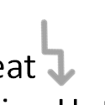
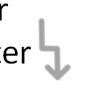


Efficiency &
Electrification
Reh
Heating Hot Wate Domestic Hot Wat
Humidification Sterilization
Waste Heat
eat
r
er
Waste to Energy

Slide 34

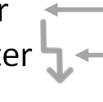

Efficiency &
Electrification
Reh
Heating Hot Wate Domestic Hot Wat
Humidification Sterilization
Waste Heat
eat
r
er
Waste to Energy
NEC

Slide 35


Efficiency &
Electrification
Reh
Heating Hot Wate Domestic Hot Wat
Humidification Sterilization
Waste Heat
eat
r
er
Waste to Energy
RNG
NEC

Slide 36









Efficiency &
Electrification
Reh
Heating Hot Wate Domestic Hot Wat
Humidification Sterilization
Waste Heat
eat
r
er
Waste to Energy
RNG
NEC

Slide 37





























Financing
Reh
Heating Hot Wate Domestic Hot Wat
eat
r
er
IRA +
Utility + State + Grants
Humidification Sterilization
Waste Heat
Waste to Energy
REC’s
Offsets RNG $
RNG

Slide 38
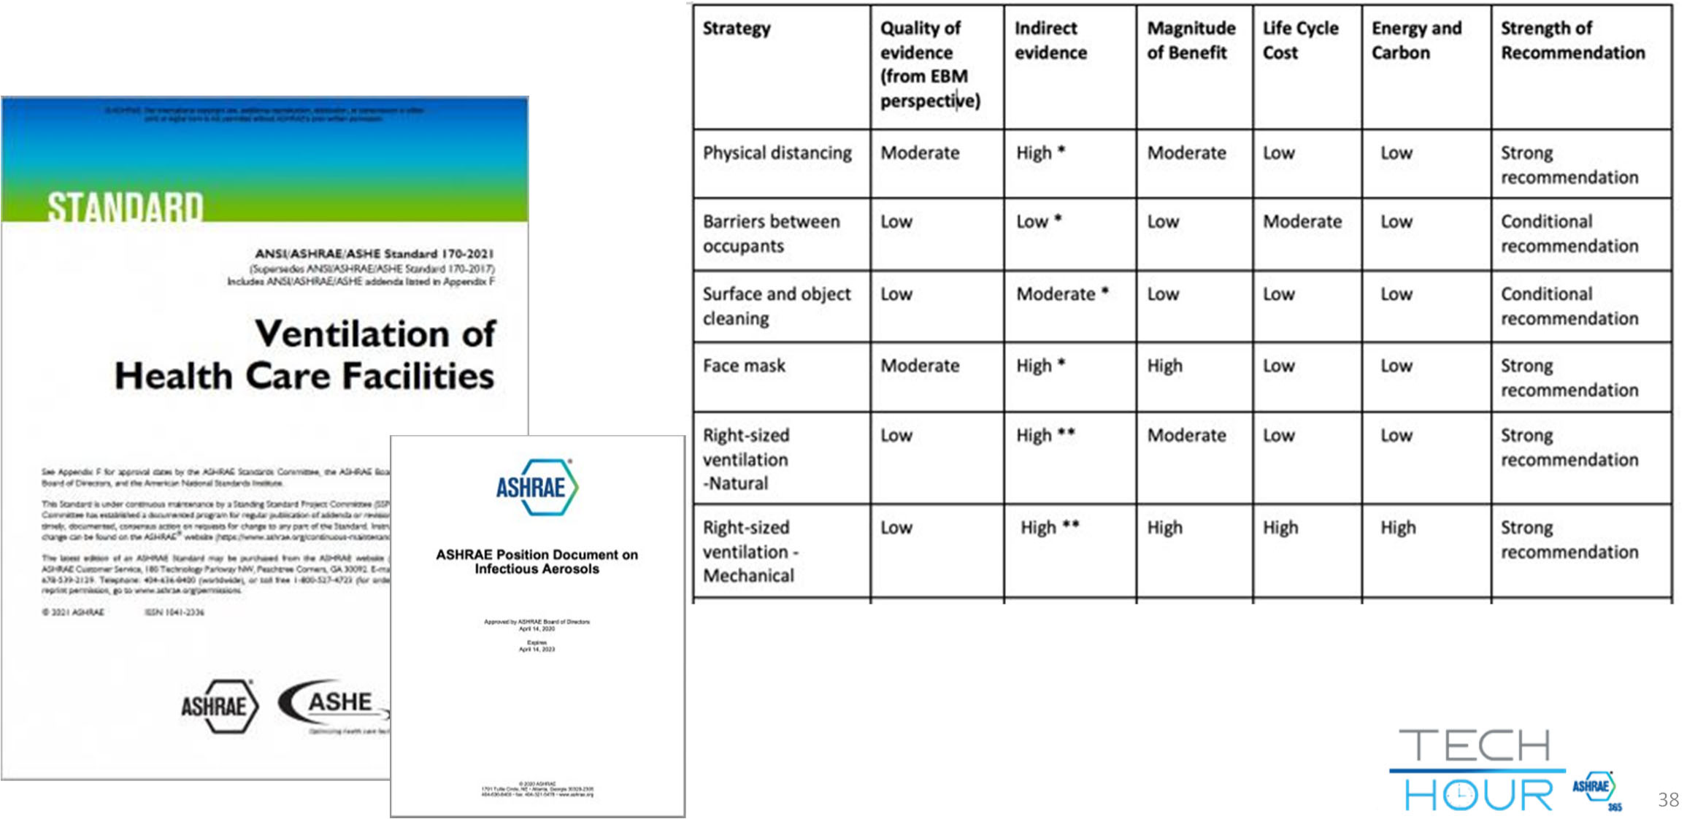
38

Slide 39

After recent NEC/NFPA
meetings, microgrids will very likely be adopted into the 2023 code.
− From a code committee member

Slide 40

The Energy Evolution – Part 1

Slide 41
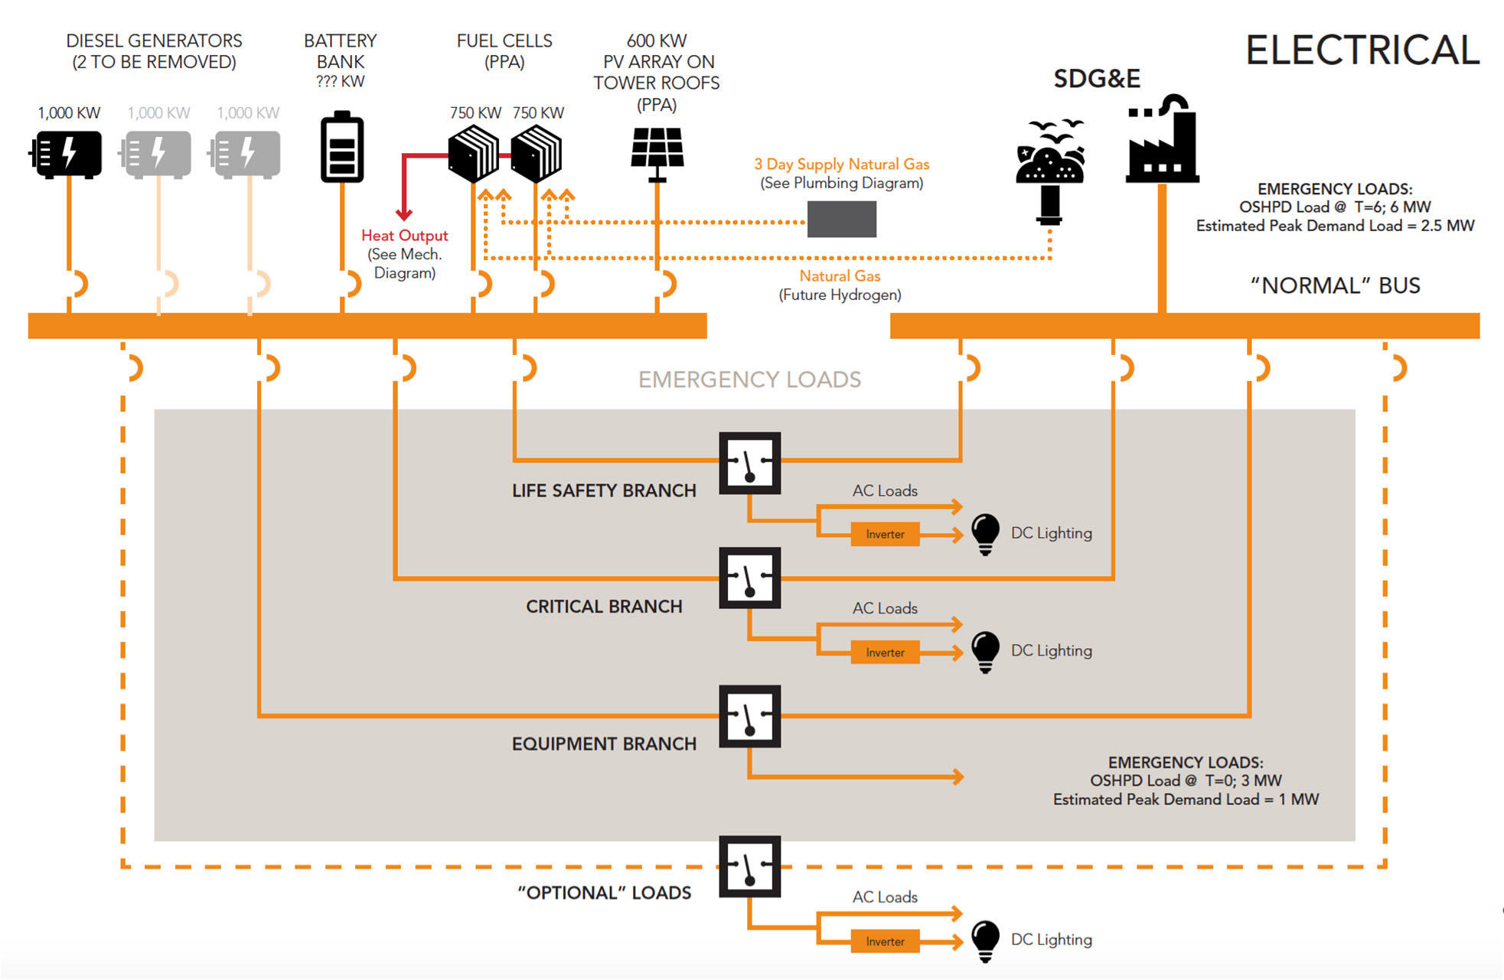

Slide 42

Microgrids

Slide 43
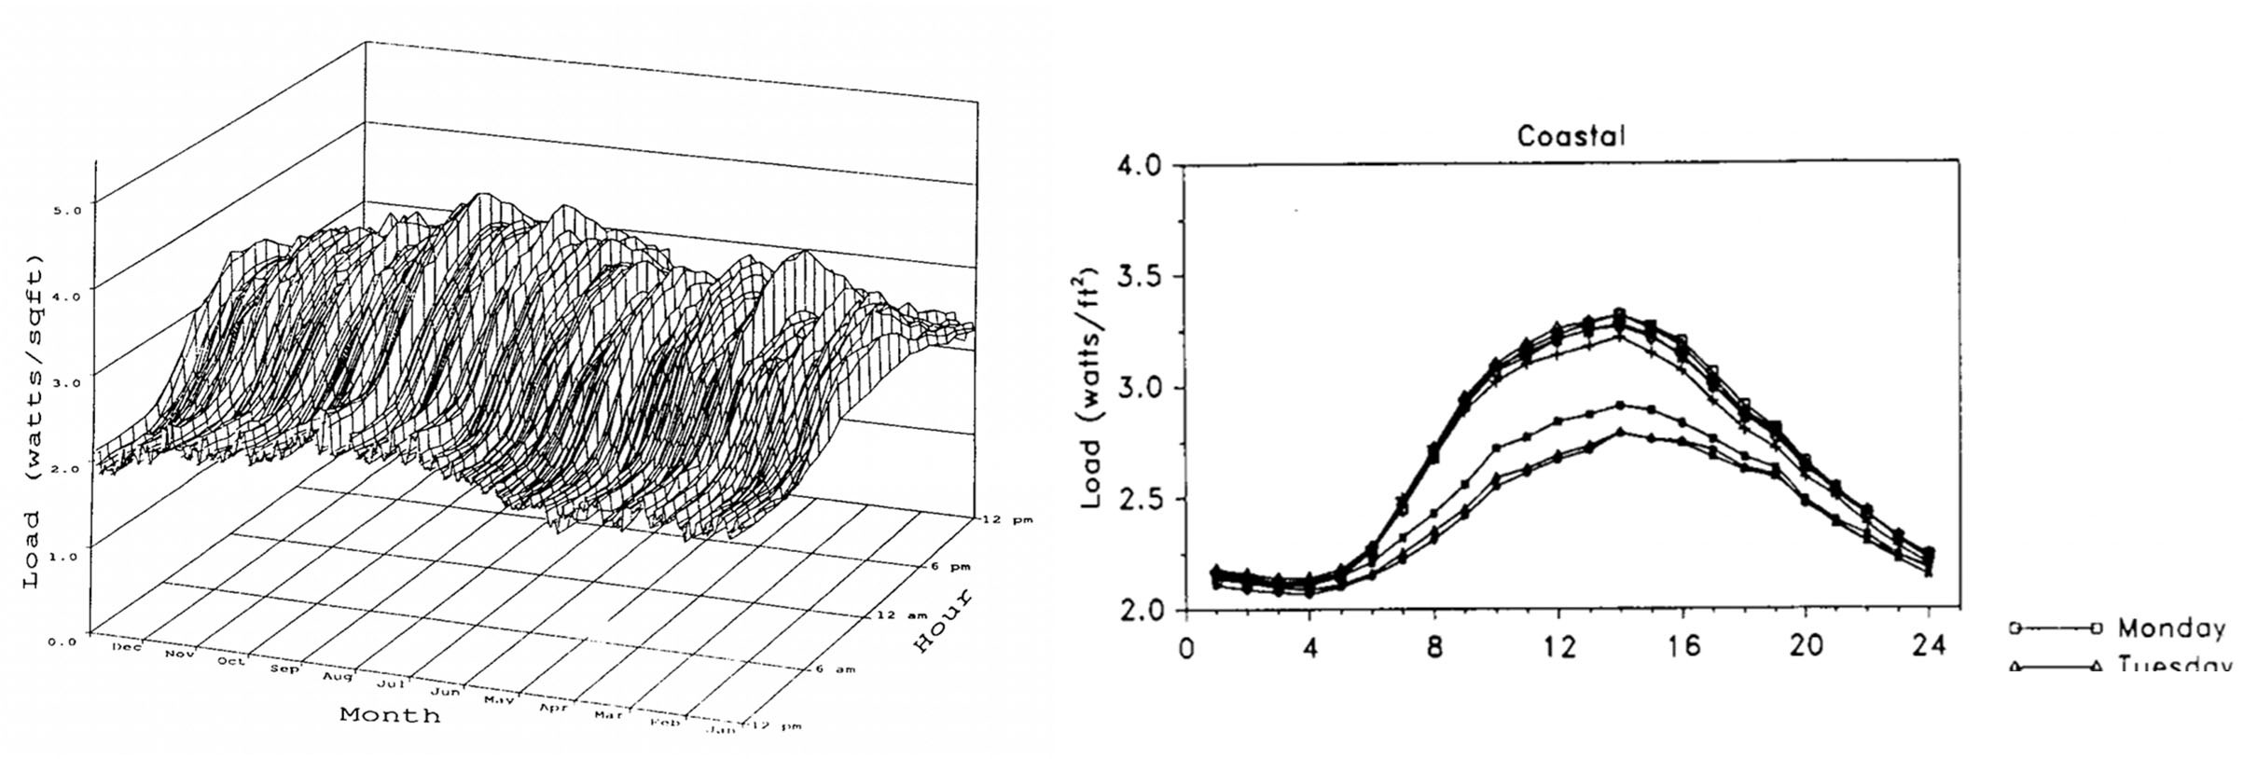
Hospital Load Profiles (Average)
Mean Hourly Loads by Day of Week for Health
Average Whole‐Building Load Shapes for Health: Coastal Region

Slide 44
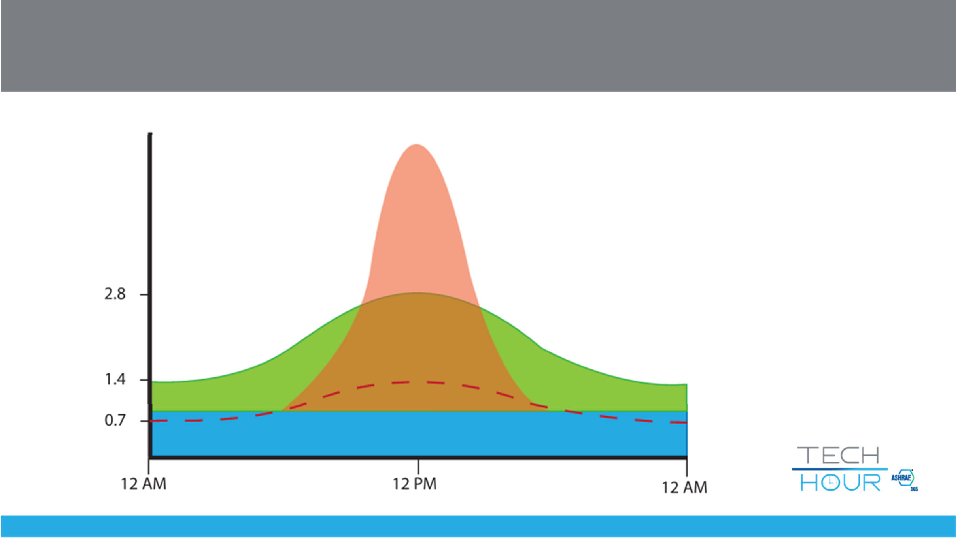
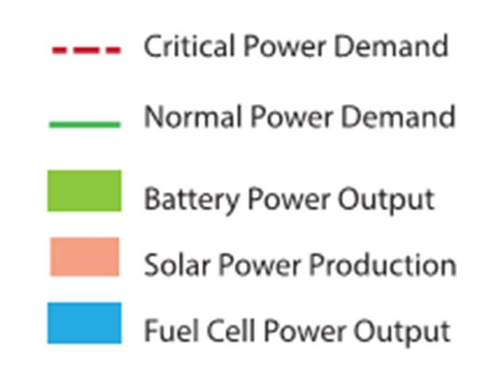

Microgrids vs Single Source Renewables

Slide 45
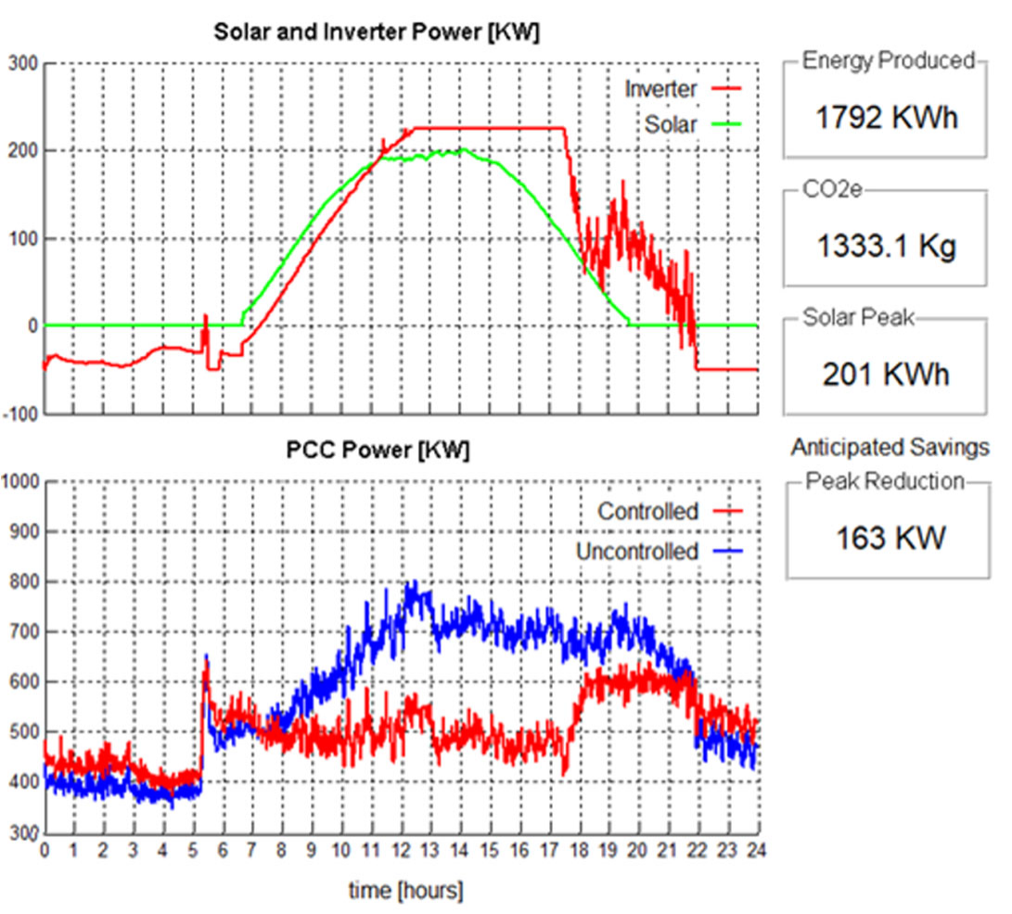
Sources of Microgrid Cost
Technology dependent: solar, fuel cell, wind, hydrogen, battery (type), controls
Regulatory requirements: CMS, State, local
Space constraints: Limited footprint for solar, batteries (unless new facility)

Slide 46

Microgrids

Slide 47


Slide 48


Slide 49


Slide 50


ashrae.org/techhour
50

